Slide 1




CISC3003
Team Project for
Macau House Rental Platform
Team 8 - Pair02&03&23
DC126711 HUI GUANHAO DC027495 DENG YIFAN DC127910 CUI JIANFU DC126057 HE GUO JHON KOU JING DC127947 MA YINGCHEN DC125611 WONG KUOK LEONG

Slide 2

C
O
N
T
E
N
T
S
INTORDUCTION
FUNCTION
TECH

Slide 3
First
INTRODUCTION
OVERVIEW OF THE WORK

Slide 4

INTORDUCTION
INTORDUCTION
FUNCTION
TECH
Macau House Rental Platform
Macau House Rental Platform is an innovative online platform designed specifically for the Macau real estate market to simplify the process of finding and renting properties. Through this platform, we hope to effectively connect landlords and tenants so that they can communicate and transact more conveniently. We hope it can become a stable platform for the Macau rental market and provide quality services to tenants and owners.
。

Slide 5
Second
FUNCTION
WORKING CONDITIONS

Slide 6

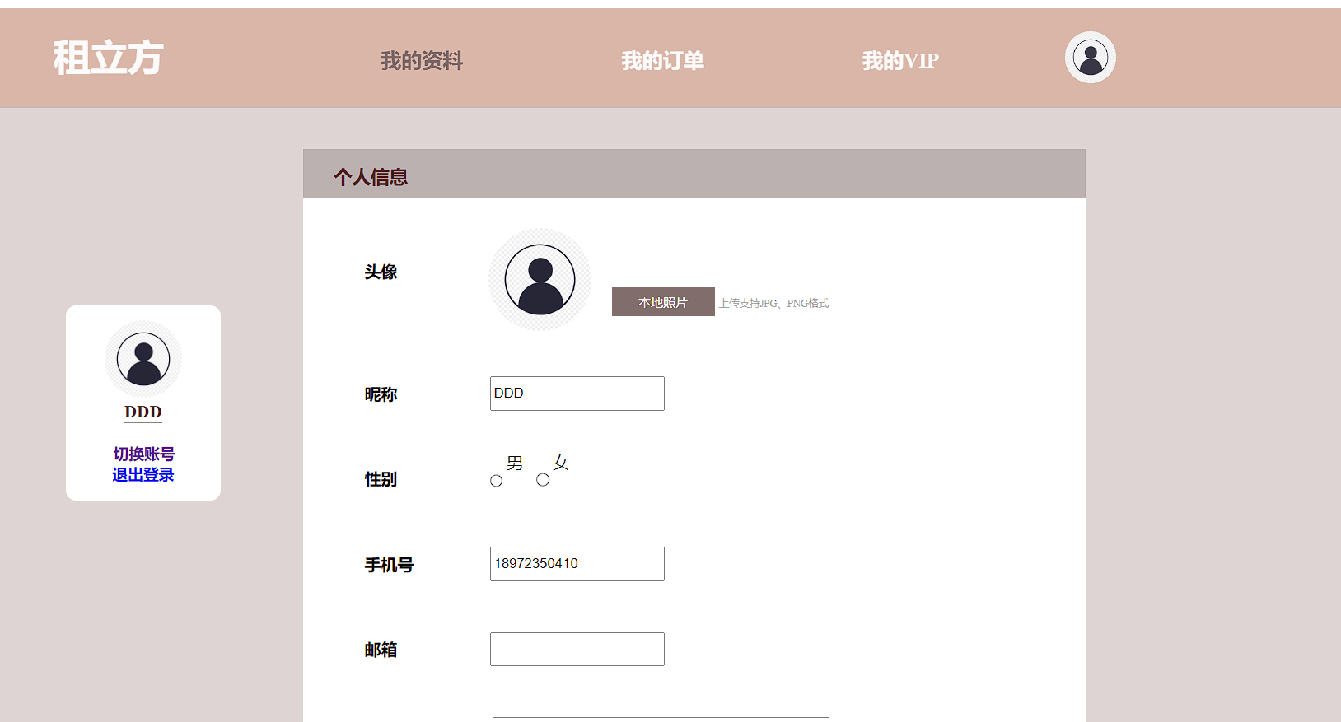
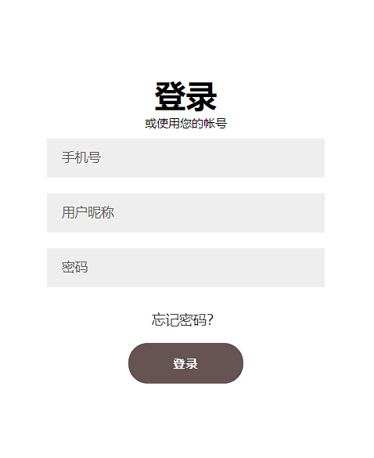
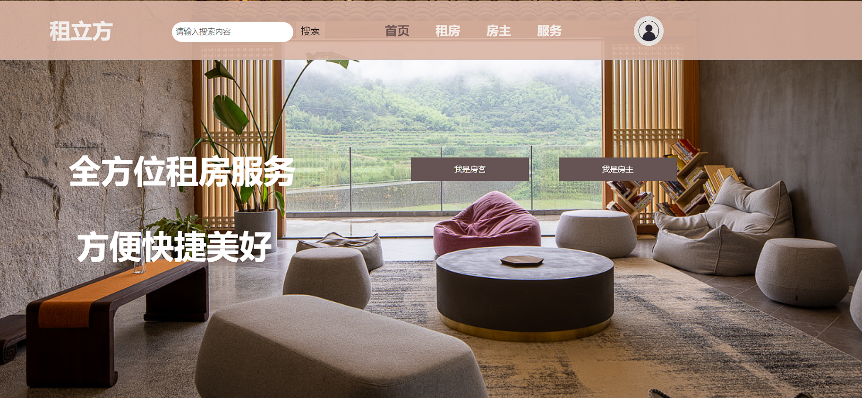
User Account Module(tenants and landlords)
FUNCTION
INTORDUCTION
TECH
First, customers need to register their own account, whether they are tenants or landlords
Third, you can view your user interface
Second, customers are required to log in to their account
Finally, if you log out, you will return to our homepage。

Slide 7
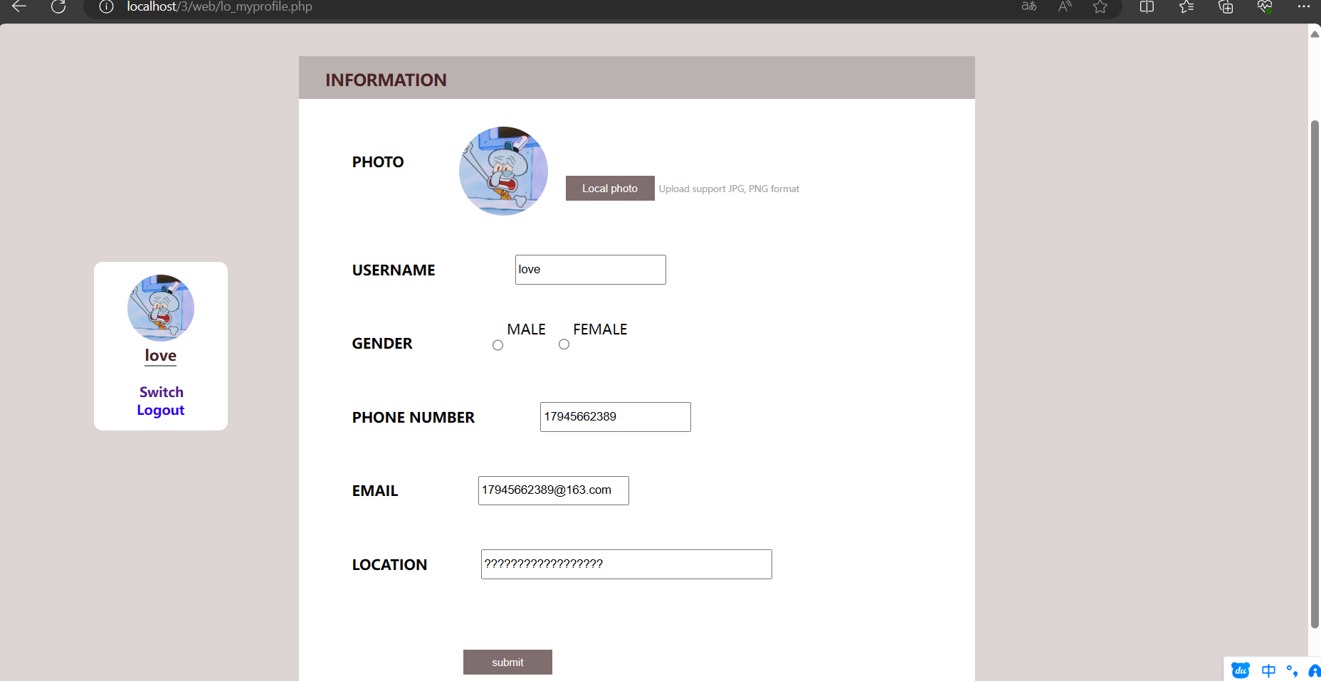
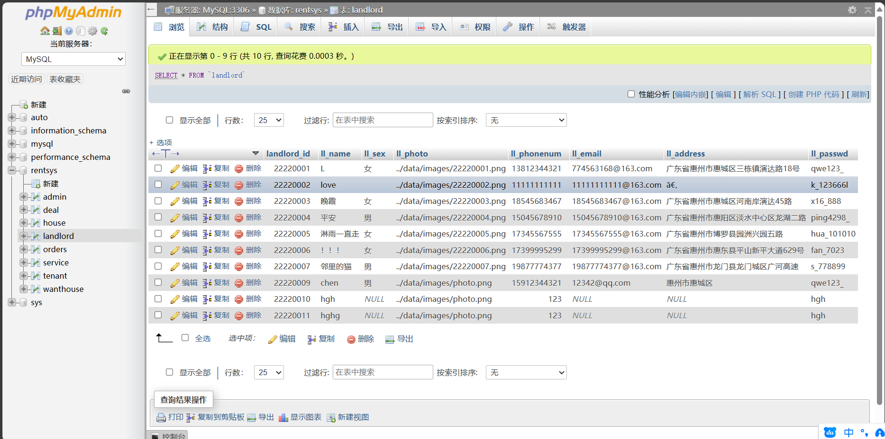
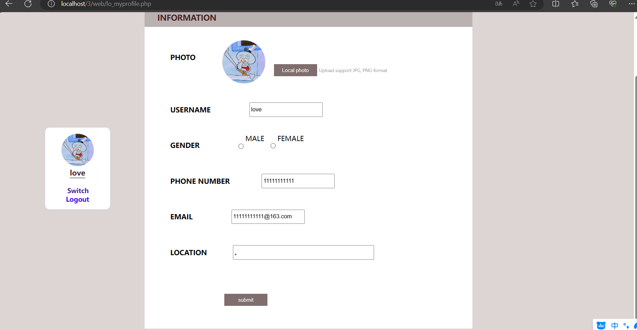
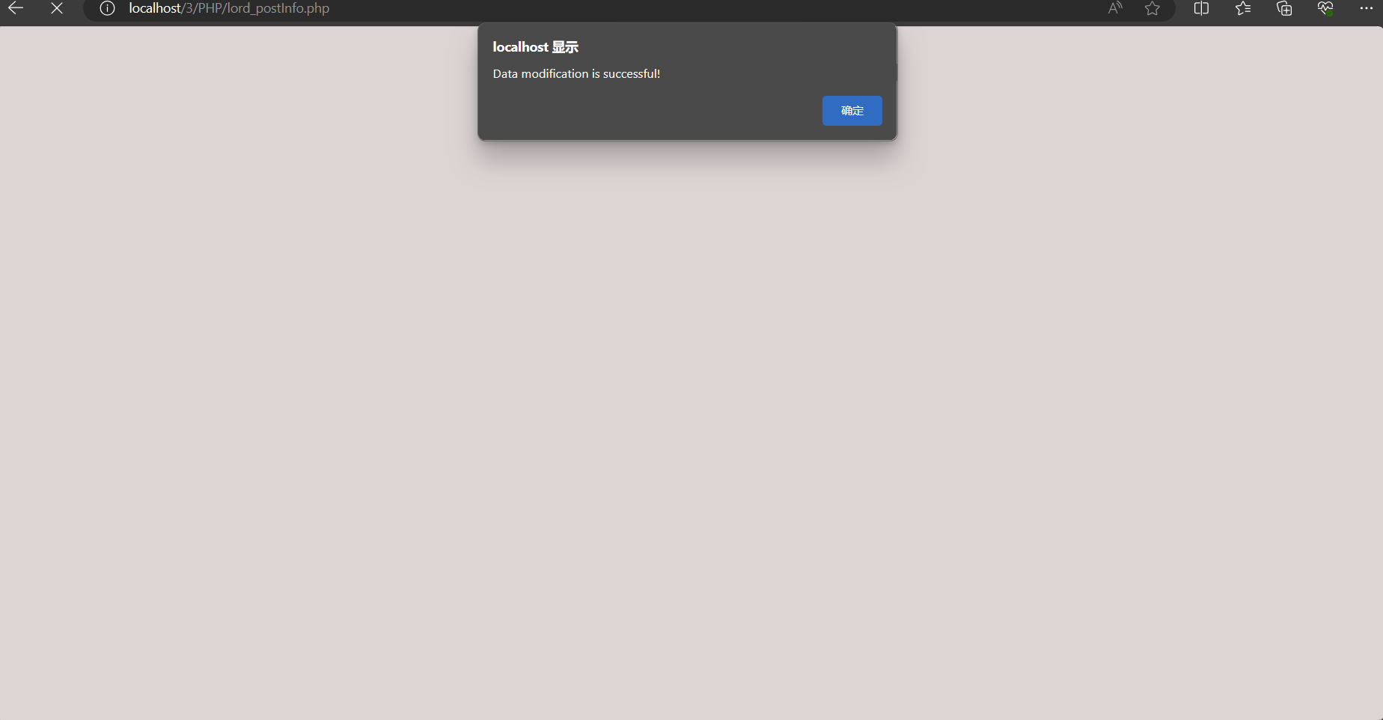
User profile(tenants and landlords)
INTORDUCTION
FUNCTION
TECH
FUNCTION
After you modify your user information, our database will also be updated simultaneously.
When you enter the user interface, you will be able to modify your user profile
After the update is successfully completed, you will be prompted that your user profile has been successfully updated.
The information available for modification includes user name, user phone number, user email address, and user address.

Slide 8
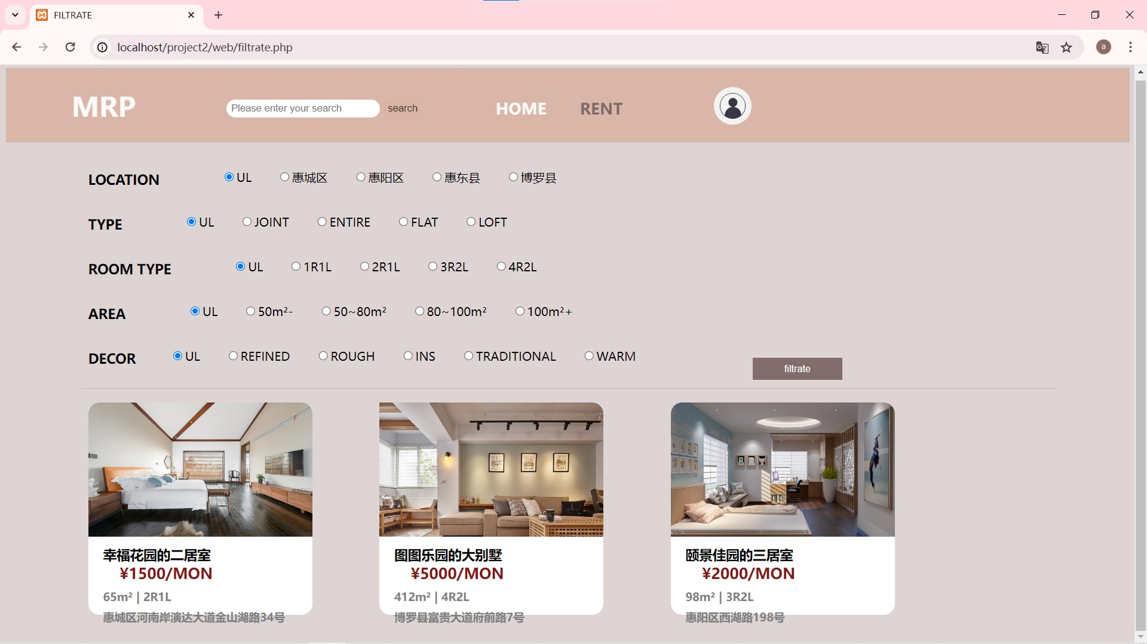
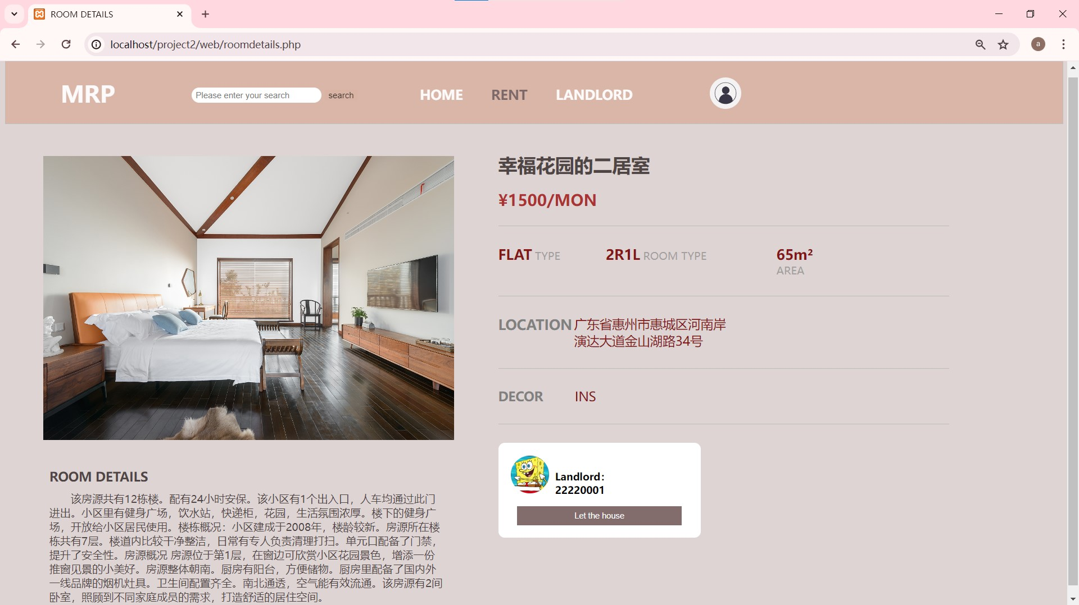
User filtrate function
INTORDUCTION
FUNCTION
TECH
Once you're logged in, you can use the search and filter functions on the home page to view your ideal rental properties
Using this function, users can easily find various information about the house they want, including rent, owner and house size.

Slide 9
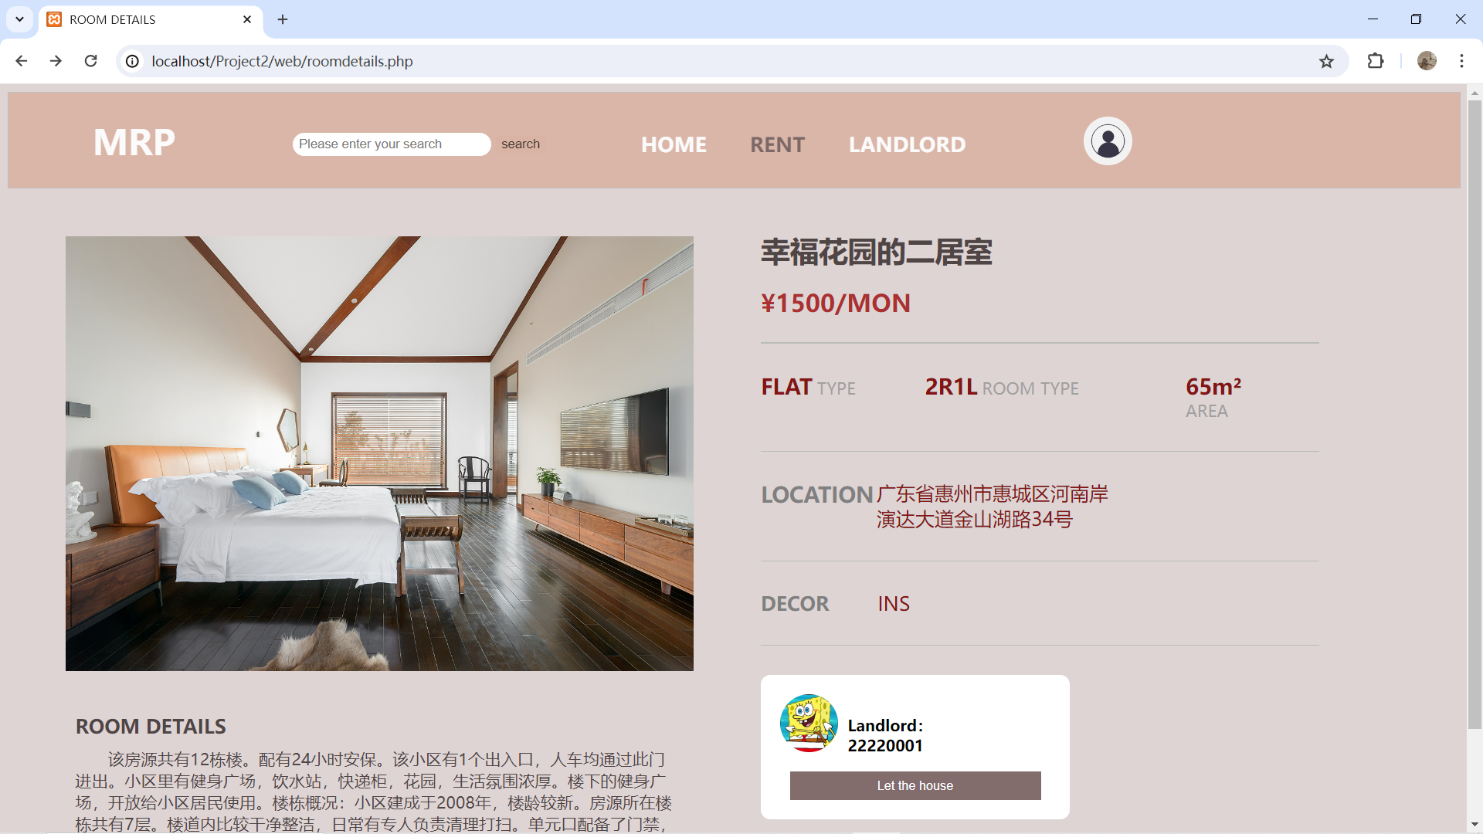
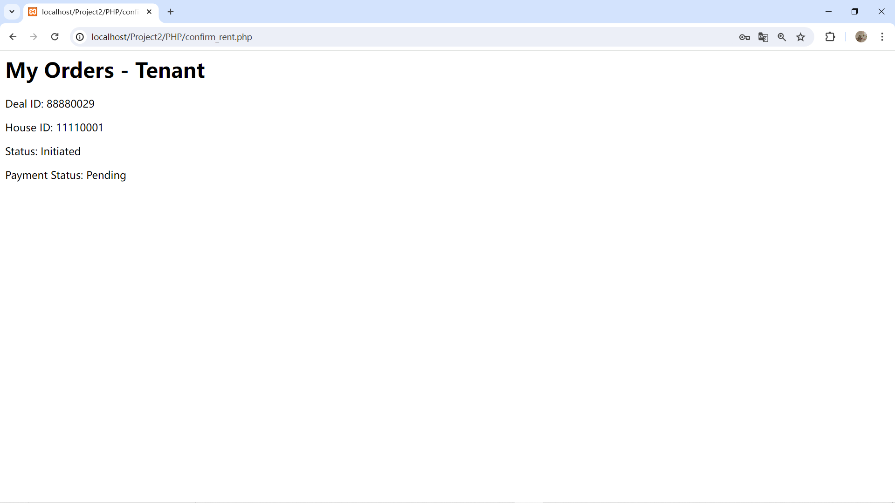
Place Order function
INTORDUCTION
FUNCTION
TECH
After you find the house you need, you can reserve the house you want through the order button
After the order is successful, the system will give you the corresponding order interface to tell you that the order is successful.

Slide 10

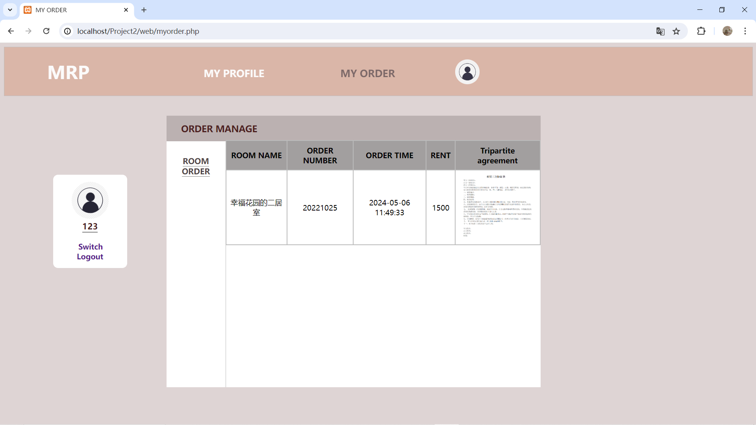
User order function
INTORDUCTION
FUNCTION
TECH
After you order the house you want, you can also find the house order you have already ordered
The order page has detailed display of when, where and price

Slide 11
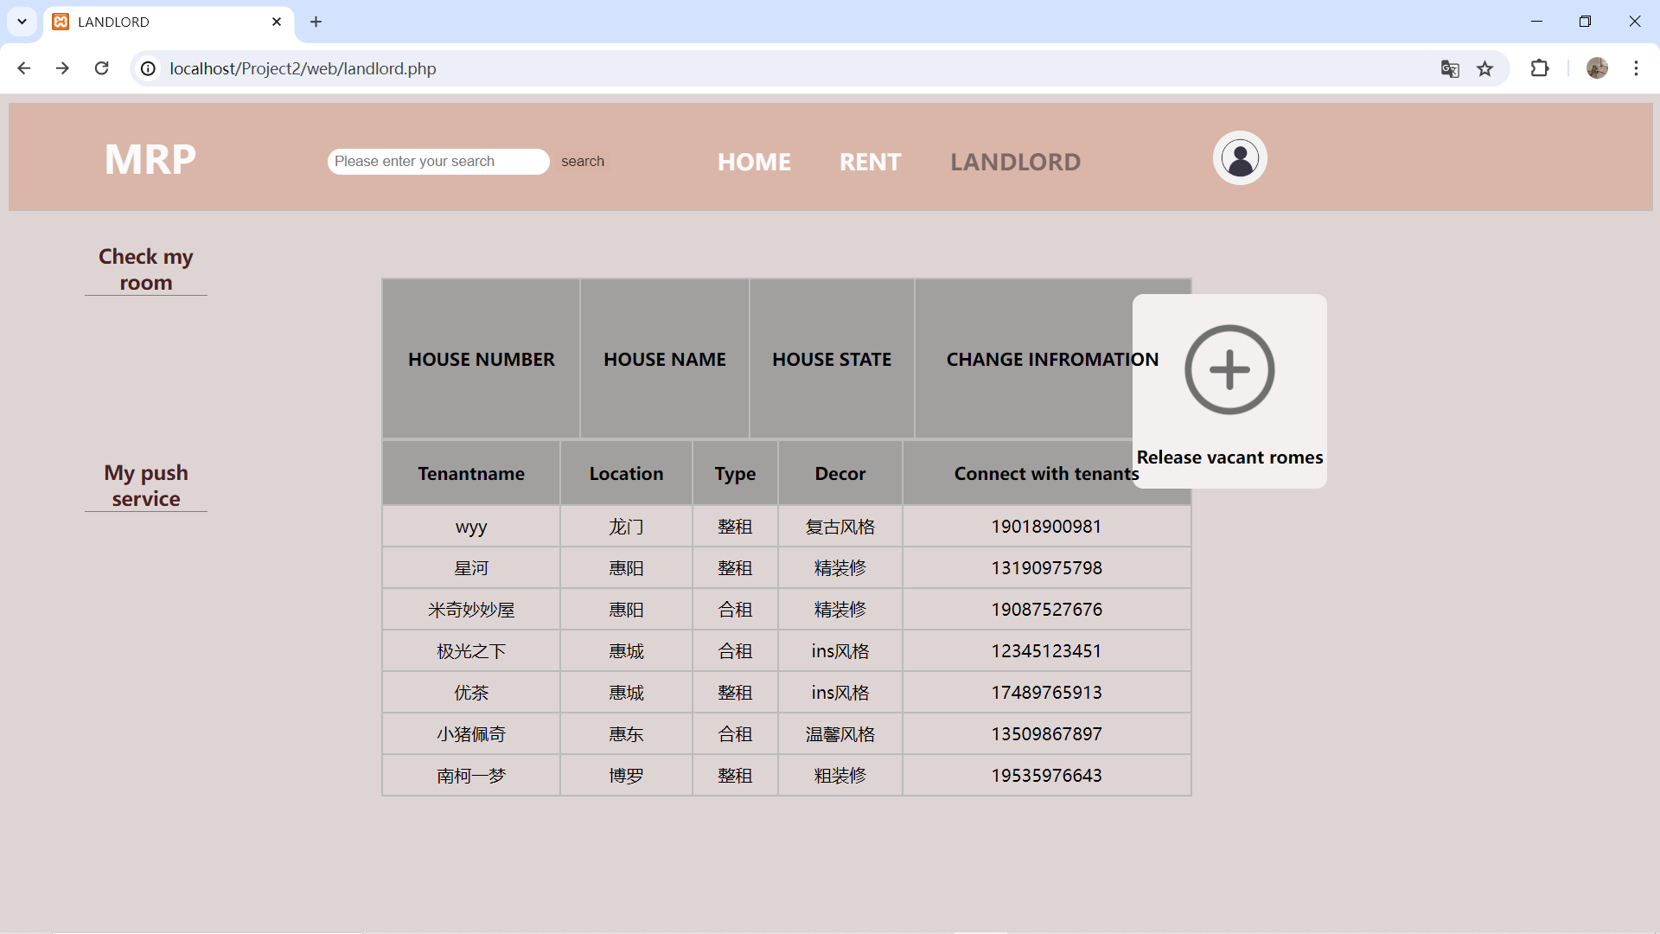
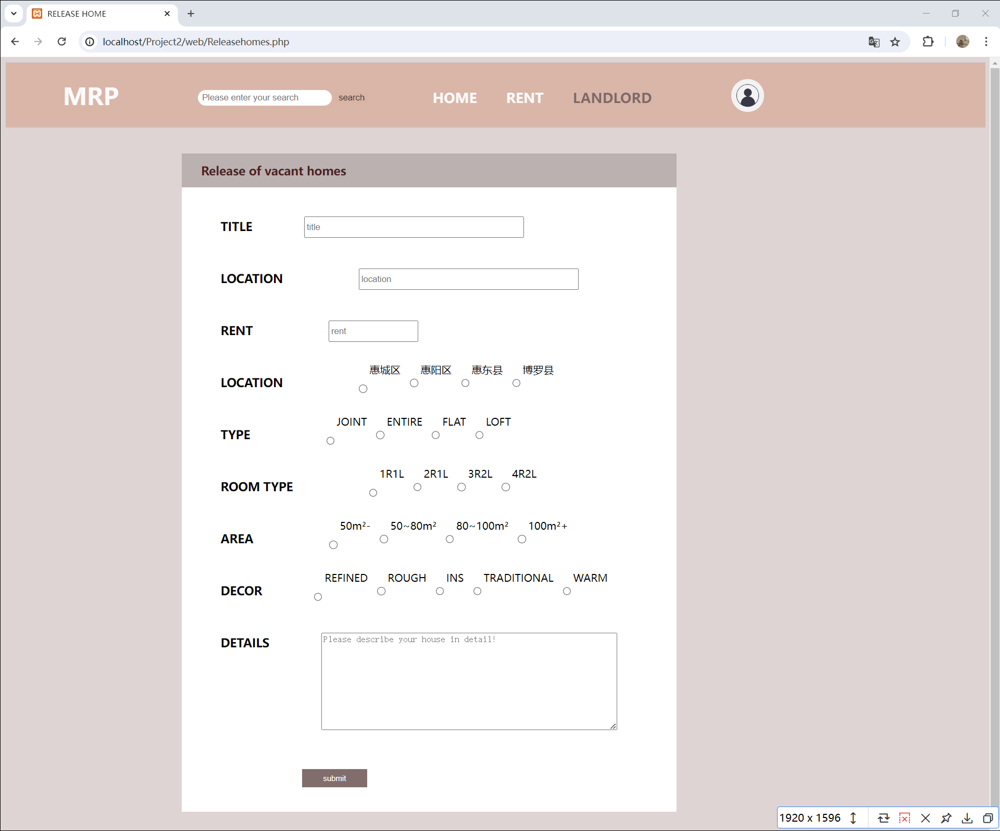
Room release function
INTORDUCTION
FUNCTION
TECH
Homeowners can also view the uploaded listings and rental status they own
You can also upload detailed new house information you own anytime and anywhere.

Slide 12
last
TECH
OVERVIEW OF THE WORK

Slide 13

HTML
02
CSS
01
The structure used to build web pages.
Used to style HTML, including layout, fonts, colors, etc.
TECH
JavaScript
03
04
React or Vue
Used to add interactivity, such as form validation, dynamic loading of content, etc.
Help create dynamic and responsive user interfaces.

Slide 14
Thanks
Team 8
DC126711 HUI GUANHAO DC027495 DENG YIFAN DC127910 CUI JIANFU DC126057 HE GUO JHON KOU JING DC127947 MA YINGCHEN DC125611 WONG KUOK LEONG

